Slide 1

Project Title: DIU CampusCart
Database Management System Lab Project Proposal
Presented by -
1. Abdullah Al Noman (232-15-797)
2. Supan Roy (232-15-716)
3. Samira Haque Vabna (232-15-764)
4. Nur Sayda (232-15-437)
5. Shakira Rahman Simi (232-15-723)
Presented to –
Mr. Muhammed Masum Bakaul Lecturer (Senior Scale), Department of Computer Science and Engineering Faculty of Science and Information Technology Daffodil International University

Slide 2

CONTENTS
Objectives
Motivation
Background Study
Gap Analysis
Key Features
Methodology/Working procedures
Members Responsibility
Expected Outcomes
Conclusion
232-15-437

Slide 3
OBJECTIVES
The primary goal of DIU CampusCart is to develop a secure and user-friendly online marketplace exclusively for DIU students residing in hostels or nearby.
Specific objectives include:
Providing a structured platform for buying and selling second-hand goods.
Ensuring authenticity by restricting access to DIU students only.
Minimizing fraud risks through an admin approval system.
Enhancing user experience with search, filtering, and product categorization.
232-15-437

Slide 4
MOTIVATION
Why This Project?
Finding the right product at the right price is often a struggle for students. Existing marketplaces are cluttered, making it difficult to locate essential goods. Many students waste time searching for required items, negotiating prices, and verifying sellers. This project aims to eliminate these hurdles and provide an efficient, student-centric solution.
This project offers:
A clean, student-centric solution
Trust through DIU email verification
A simple and efficient way to trade goods on campus
232-15-716

Slide 5


BACKGROUND STUDY
1. Bikroy.com
Popular Bangladeshi classified ads website.
Allows users to buy/sell products across categories.
Open to all users, lacks campus-specific targeting.
No academic email verification, so lacks trust in student-to-student trades.
2. Facebook Marketplace (Buy-Sell Groups)
Students often buy/sell items via FB groups or Marketplace.
No built-in verification system – anyone can join.
Hard to filter relevant posts & no proper category system.
Trust and safety concerns with strangers.
232-15-716

Slide 6
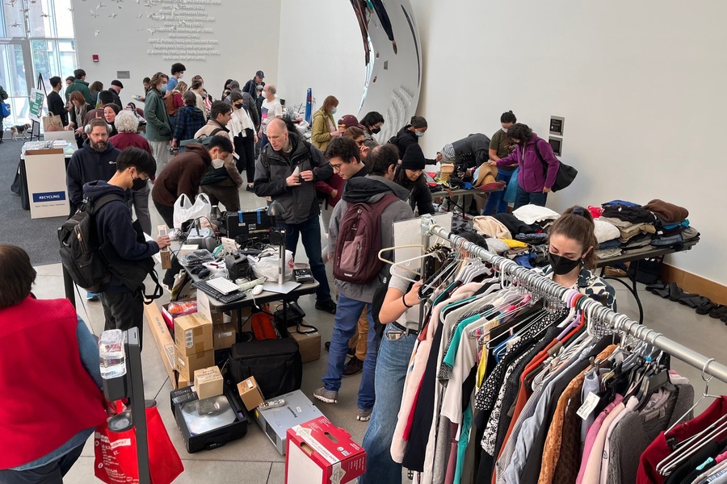
BACKGROUND STUDY
📚 3. Campus Classified Portals (e.g., MIT Reuse)
MIT Reuse a program at the Massachusetts Institute of Technology that facilitates the exchange and reuse of items within the MIT community.
Internal marketplaces for students.
Verified access using university email.
Focus on trust, simplicity, and academic community only.
[Image Courtesy: MIT News ]
232-15-716

Slide 7
GAP ANALYSIS
Shortcomings of Existing Systems
No dedicated DIU marketplace – Students compete with external buyers and sellers, making transactions less convenient and less reliable.
No smart filtering or search – Students waste time scrolling through unorganized posts, struggling to find relevant products quickly.
No structured product categorization – Products are randomly listed in Telegram or Facebook groups, making it hard to browse efficiently.
Lack of verification & trust – No system ensures sellers and buyers are genuine, leading to scams and misleading product information.
Security risks & fraud – Open platforms allow anonymous users, increasing the risk of fraud, misleading listings, and price manipulation.
232-15-764

Slide 8
GAP ANALYSIS
How DIU CampusCart Addresses These Gaps
DIU-Exclusive Access: Only DIU students, teachers or employees (via @diu.edu.bd) can register and participate.
Categorized Listings: Goods will be sorted by category, price, and availability.
User-Friendly Interface: Designed specifically for DIU students’ ease of use.
Cash on Delivery System: Transactions will be conducted through direct meet-ups, ensuring security and convenience in the absence of an online payment gateway.
Search and Filter Features: Enables quick discovery of necessary products.
232-15-764

Slide 9
KEY FEATURES
✓ Security Features
1. DIU Email Verification for Account Creation
2. Admin Section for Monitoring Activities
✓ Product Management 3. Product Listings with Categories & Search 4. Seller Dashboard (Manage Listings, Mark as Sold) 5. Auto Expiry of Listings after 30 Days
✓ Buying & Communication 6. Buyer Dashboard (View, Send Buy Requests) 7. Email Notifications for Buy Requests 8. In-App Messaging Between Buyer & Seller 9. Wishlist / Favorites Feature
✓ Trust & Feedback 10. Basic Rating & Review System for Buyers & Sellers
232-15-797

Slide 10
METHODOLOGY/WORKING PROCEDURE
Requirement Analysis
System Design
Technology Stack Selection
Frontend: HTML, Tailwind CSS
, JavaScript
Backend: Python, Django
Database: MySQL
Development Phase
Testing & Debugging
Deployment & Maintenance
232-15-797

Slide 11
MEMBERS RESPONSIBILITY
Team Member | Responsibility
1. Abdullah Al Noman (232-15-797) | Team Lead - Full Stack, Django, DBMS
2. Supan Roy (232-15-716) | Frontend, Database
3. Samira Haque Vabna (232-15-764) | UI design, Database
4. Nur Sayda (232-15-437) | Managing dummy data, Testing
5. Shakira Rahman Simi (232-15-723) | Data collection, Report writing
232-15-797

Slide 12
EXPECTED OUTCOMES
By the end of the project, DIU CampusCart will:
Be a fully functional, secure DIU-only marketplace.
Enable efficient buying/selling via dashboards.
Allow direct communication between users.
Improve trust using ratings and verified emails.
Offer better user experience with favorites and listing expiry.
Provide admin tools for monitoring, approving, and managing activities.
232-15-723

Slide 13
CONCLUSION
DIU CampusCart is made to help students buy and sell things easily and safely inside the DIU campus.
From finding affordable items to connecting with fellow students in a safe and trusted environment — this platform brings the DIU community closer together. By focusing on the real needs of students and adding features that truly matter, we’re not just building a website — we’re building a solution that reflects student life, trust, and convenience.
With your support and feedback, we hope to turn this project into something every DIU student can rely on.
232-15-723

Slide 14
Thank You

